Slide 1
Banglore RapidoRide Analytics: Trends, Demand Forecasting by-Abhinav Rawat

Slide 2
Rapido
Rapido is an Indian ride-hailing service, which primarily operates as a bike taxi aggregator. Its offerings also include auto rickshaw and taxicab hailing, parcel delivery, and third-party logistics services. Founded in 2015, the company is based in Bangalore and operates in over 100 cities.

Slide 3
Problem Statement
With the rapid growth of ride-sharing services in metropolitan areas, managing ride demand, optimizing service availability, and understanding fare patterns have become crucial for service providers like Rapido. The dynamic nature of the ride-sharing market, with fluctuations in demand across different times of day, seasons, and geographic regions, presents a unique challenge for efficient operations and resource allocation.

Slide 4
Data Summary The dataset contains information about ride-sharing services (such as Rapido) including details about rides, ride status, fares, and geographical locations, along with relevant time and payment data. It also includes various numerical and categorical attributes that help analyze the ride demand, fare patterns, and cancellation trends.
Date
Time
Ride Status
Service
Source
Destination
payment method
Duration
Ride id
Max Required
Distance
Ride charge
Misc charge
Total fare

Slide 5
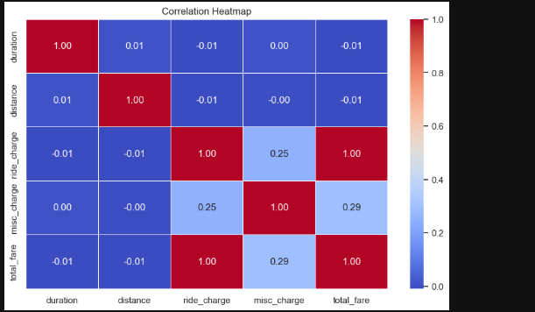
Correlation Matrix

Slide 6
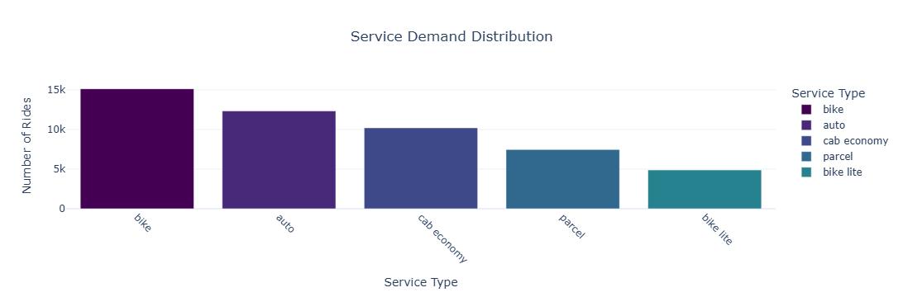
EDA Service Demand Distribution

Slide 7
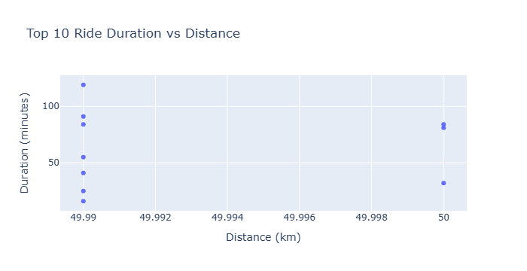
Ride Duration vs Distance

Slide 8
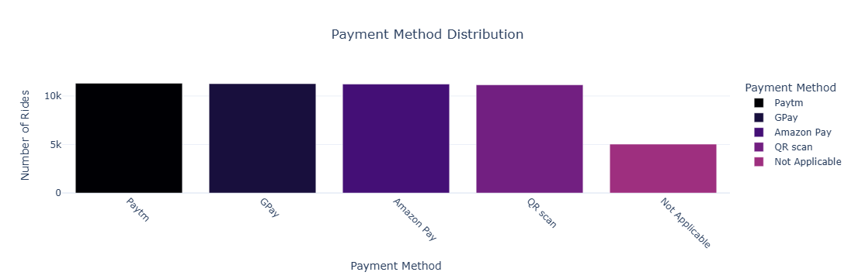
Payment Method Distribution

Slide 9
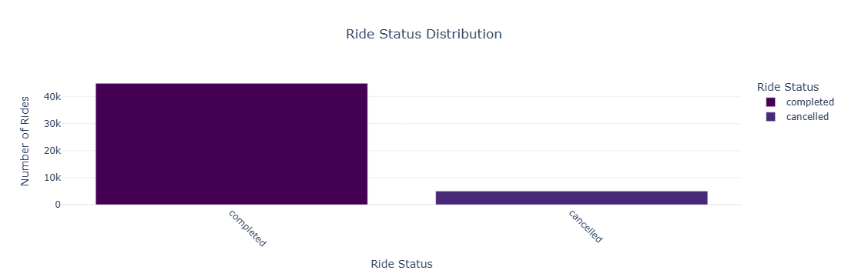
Ride Status Distribution

Slide 10
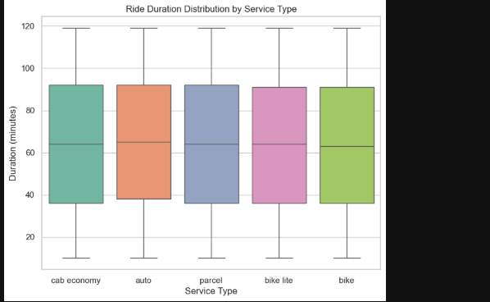
Ride Duration Distribution by Service Type

Slide 11
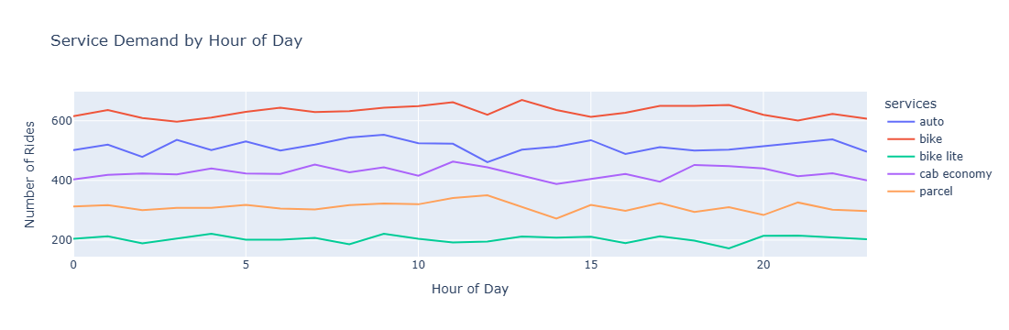
Service Demand by Hour of Day

Slide 12
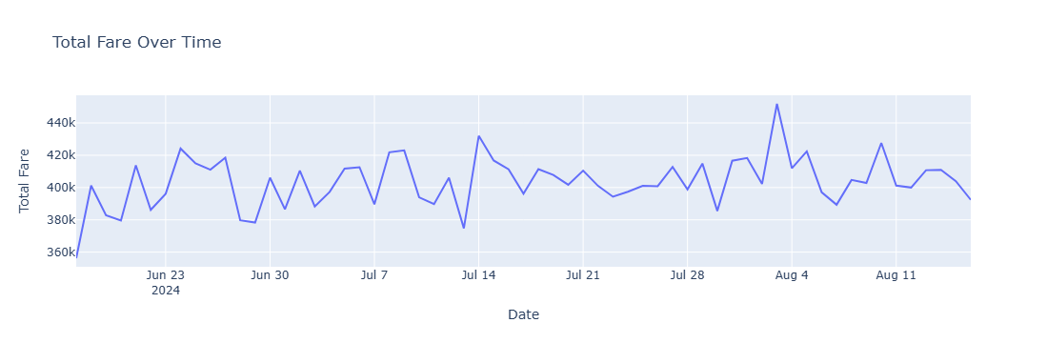
Total Fare Over Time

Slide 13
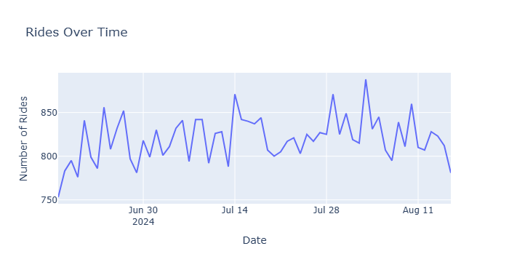
Ride Over Time

Slide 14
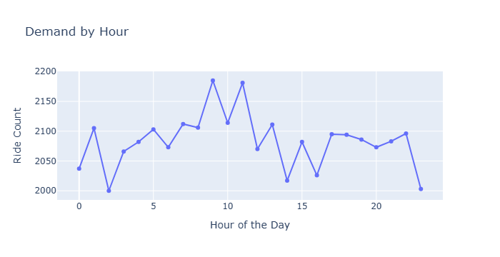
Demand by Hour

Slide 15
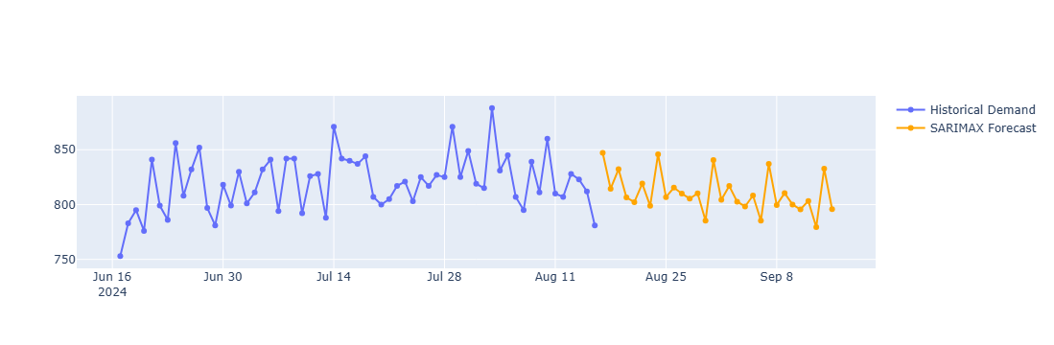
SARIMAX Forecast for Ride Demand For Next 30 Days

Slide 16
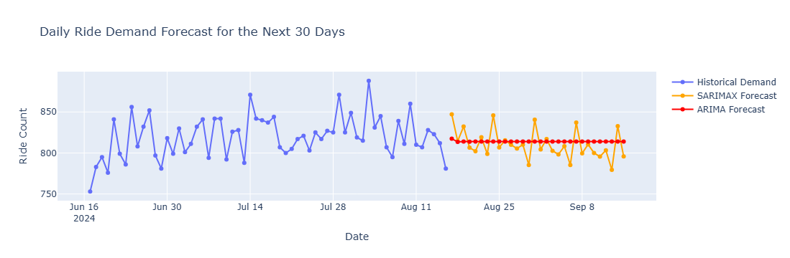
ARIMA forecast for Ride Demand For Next 30 Days

Slide 17
Conclusions
High demand for bike services during early mornings, auto and cab demand peaks in the afternoon and evening.
Ride counts fluctuate over time, with consistent peaks during specific periods.
Paytm and GPay are the most popular payment methods, possibly influenced by promotions.
Bike services are the most preferred, offering consistent ride durations, while auto and cab services show more variability.
ARIMA and SARIMAX models suggest growing demand with daily fluctuations.

Slide 18
Recommendation
Increase bike availability during morning hours and prioritize auto/cab services in the evening.
Promote bike services as a cost-effective, quick option for short-distance travel..
For auto and cab services, focus on improving ride consistency by reducing variability in ride durations (e.g., through better route optimization or partnerships with local authorities to reduce traffic bottlenecks).
Capitalize on Paytm and GPay’s popularity by offering time-limited discounts to further drive engagement.
Promote premium cab services during evenings for social outings or corporate travel to attract higher-paying customers.

Slide 19
Thank You

